Slide 1
SFWR TECH 4DA3
Data Analytics and Big Data
Instructor: Dr. Jeff Fortuna, B. Eng, M. Eng, PhD, (Electrical Engineering), McMaster University
email: fortunjj@mcmaster.ca

Slide 2
Course Information
Calendar Description | Mathematical Concepts, Statistical Data Analysis, Big Data Architectures.
Course Objectives | The focus of the course is on providing a foundation for the study of classification and regression algorithms. Additionally, modern approaches to implementing Big Data systems are examined. Each of these concepts will be examined in theory and in practice (using Python for illustration of the method and for solving a medium scale problem)
Required Text | Title: The Elements of Statistical Learning Author: Trevor Hastie, Robert Tibshirani, Jerome Friedman ISBN: 978-0-387-84857-0
Supplemental Texts | Title: Data Analytics Made Accessible Author: Anil Maheshwari eBook on Amazon
Pre-requisite | ENG TECH 3ST3 (Engineering Statistics)

Slide 3
Course Information
This course features statistical approaches to using a computer to extract useful information from data.
These approaches are complex and must be described using the language of mathematics
The notes will give you the appropriate description of the approach via mathematics.

Slide 4
Course Assessment
 | weight
Project Implement a solution to a medium-scale regression problem and a medium-scale classification problem using an approach discussed in the course | 30%
Assignments Each topic covered will be exemplified with problems to be solved using Python code as appropriate. | 70%

Slide 5
Course Outline
 | Introduction to Statistical Data Analysis
 | Maximum Likelihood Estimation
 | Fisher’s Linear Discriminant
 | Feature Extraction 1
 | Feature Extraction 2
 | Classifier Performance and Model Selection
 | Big Data Architectures I
 | Big Data Architectures II

Slide 6
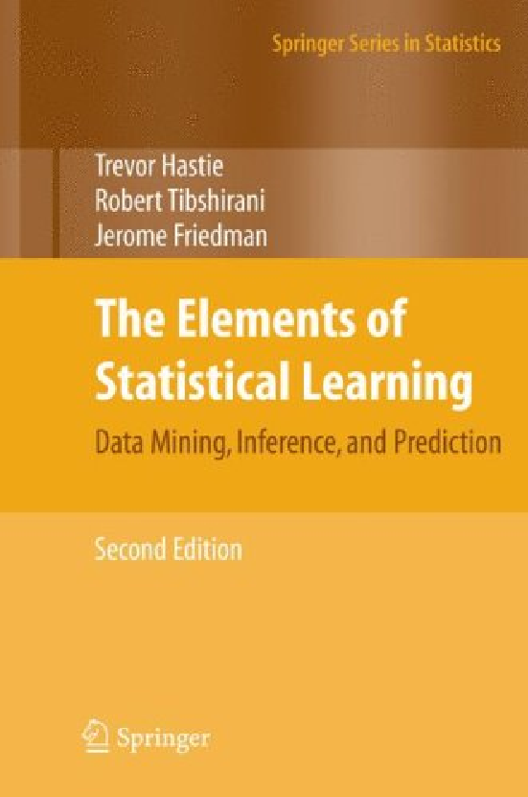
Course Text
The Elements of Statistical Learning
PROS
Digital copy is free for Mac students through Springerlink from the library
Thorough coverage of the theory
Suitable for undergrad and grad study
Well-respected book by well-respected authors
CONS
Not easy to learn from – it is more comprehensive than it is instructive

Slide 7
My Past Work in Machine Learning
J. Fortuna, A. Elzibak, Z. Fan, J.F. MacGregor, and M.D. Noseworthy, (2011), Liver Functional MRI Analysis Using a Latent Variables Approach, Journal of Chemometrics, Vol. 26, No. 5, pp. 170--179, May 2012.
J. Fortuna and D. Capson (2004), Improved Support Vector Classification Using PCA and ICA Feature Space Modification, Pattern Recognition Journal, Vol. 37, No. 6, pp. 1117--1129, June 2004.
J. Fortuna and D. Capson (2006), An Optimal Basis for Feature Extraction with Support Vector Machine Classification Using the Radius-Margin Bound, Proceedings of the International Conference on Acoustics, Speech and Signal Processing (ICASSP 2006), Toulouse, France, May 2006, Vol. 5, pp. 565--568.
J. Fortuna and D. Capson (2004), ICA Filters for Lighting Invariant Face Recognition, Proceedings of the International Conference on Pattern Recognition (ICPR 2004), Cambridge, UK., August 2004, Vol. 1, pp. 334—337
J. Fortuna, D. Schuurman and D. Capson (2002), A Comparison of PCA and ICA for Object Recognition Under Varying Illumination, Proceedings of the International Conference on Pattern Recognition (ICPR 2002), Quebec City, Canada, August 2002, Vol. 3, pp. 11--15.

Slide 8
Statistics we will use in this course…
We will need to use some specific concepts from statistics and probability in this course
Some of them are covered in our Probability and Statistics ENG TECH 3ST3 course, some are not
I will very quickly review these concepts:
  Multivariate descriptive statistics
  Multivariate probability distributions
  Conditional probability

Slide 9
Some Context…
In this course, we will use unorganized data as input and we will apply algorithms which will group and classify data. Further, we will attempt to make predictions about the structure of data that we have not yet seen.
We will employ machine learning algorithms and statistical approaches.
The unorganized data will most often be in the form of a vector of data values (attributes) for each example.

Slide 10
Data (briefly, for now…)
Most often in this course we will be working with numerical data (data in the form of numbers).
In the Data Mining course, we generalize data to include binary and nominal types.
A data set can then be represented as a matrix

Slide 11

Data Matrix
Age | Height (in) | Weight (lb) | Income (000 $) | IQ
20 | 70 | 165 | 31 | 120
35 | 72 | 175 | 46 | 115
28 | 68 | 183 | 86 | 135
58 | 73 | 210 | 128 | 128
29 | 65 | 200 | 35 | 90
This provides a 5x5 matrix, with each data element being a row (with 5 dimensions (attributes))
Each data element is then a row vector:

Slide 12
Multivariate Descriptive Statistics
Since we are working with a matrix of data and each data element is a vector, we will be using multivariate statistics
Generally, we can gather stats across both dimensions of the data matrix – i.e. row-wise or column-wise.
Often we will be calculating the mean and variance

Slide 13
Vector Notation
Most commonly, vectors are a column of data:
Unfortunately, data matrices are typically written where a data point is a row of data with attributes as columns of the matrix.
Therefore, our data matrix will be composed of transposed (a column becomes a row) vectors representing each data point.

Slide 14
Notation

Slide 15
Covariance Matrix
At times we will need to summarize the covariance of the data points
We can summarize this with the calculation of a covariance matrix. This gives us the variance as well (on the diagonal).

Slide 16
Covariance Matrix - calculation
Note: n is the number of rows in the data matrix

Slide 17
Probability and Random Vectors
Simple idea:
Each data point is a (multivariate) example drawn from a (generally unknown) probability distribution of a process that generates data.
NOTE: Don’t overthink this – all I am saying is that each row of the data matrix is considered as a single example from a generating process – whatever that is and however complex it is. In that way the entire generating process is described by a single random vector!
Therefore, a process that generates data with n elements is nothing more than a random vector (written as a row).

Slide 18
Random vectors
  An n-dimensional random vector consists of n random variables all associated with the same probability space.
    Each outcome dictates the value of every random variable.
  Example 2-D random vector:
    where x₁ is random variable of human heights
    x₂ is random variable of wake-up times
  Sample n times from x.
Let’s collect some samples and graph them:
x₂
(wake-up times)
x₁ (heights)

Slide 19
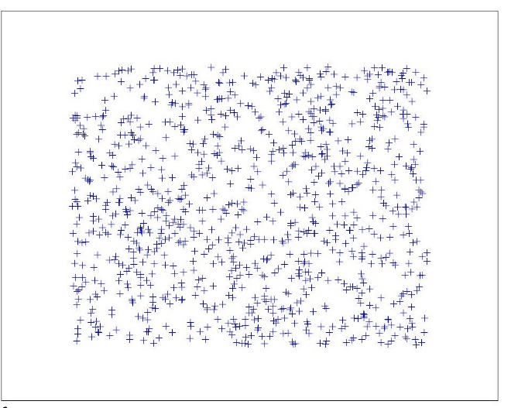
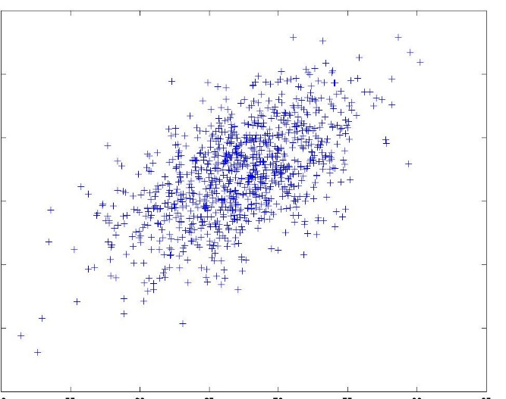
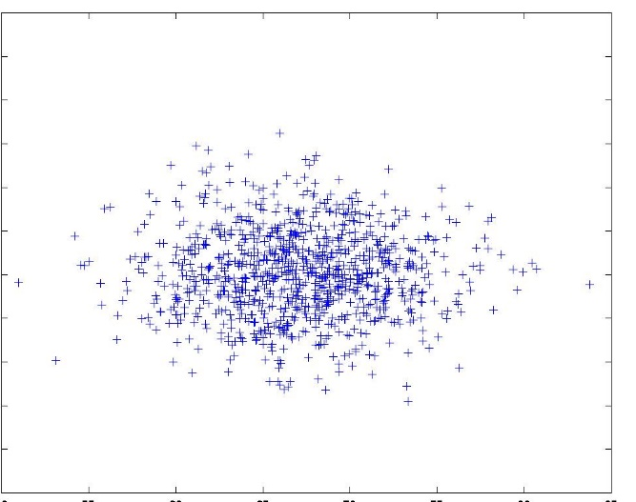
Random Vectors
The probability distribution of the random vector P(x) is P(x₁, x₂) , the joint probability distribution of the random variables x₁ and x₂.
What will the graph of samples from x look like?
x₁ uncorrelated with x₂
x₁ correlated with x₂

Slide 20
Notation

Slide 21
A Simple (and completely artificial) Example
Assume that the data was generated from a Gaussian (normally distributed) random process…
What does the probability density function (pdf) look like?
What is the expected value?
What is the covariance?

Slide 22
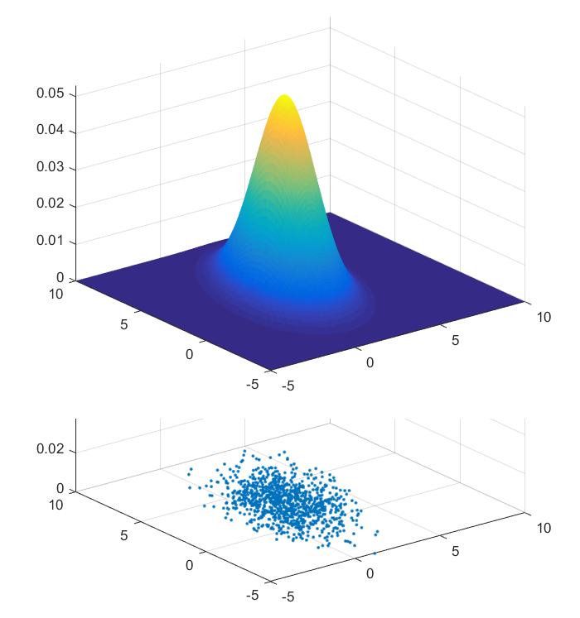
Gaussian PDF
density function
data scatter plot

Slide 23
Estimating µ, Σ

Slide 24
Probability Models
If one knows something about the process that generated the data, a function can be used to describe the probability density:
Most of the time, our variables will be continuous (they can take on real values. Therefore our function will need to have the following properties:

Slide 25
Things to note…
Our multivariate Gaussian PDF was just one such example of a probability model (arguably the most common). It can be completely described by the mean and covariance (they are the ONLY parameters required in the model):
parameters
One can estimate the mean and covariance of any set of data but most data sets are NOT completely described by a model that has only mean and covariance as parameters
Therefore we will have to do more work than just estimating mean and variance in order to build a probabilistic model which describes our data.

Slide 26
Conditional Probability
The idea here is to integrate out all variables other than ONE of them. In other words, we are looking at each variable separately.

Slide 27
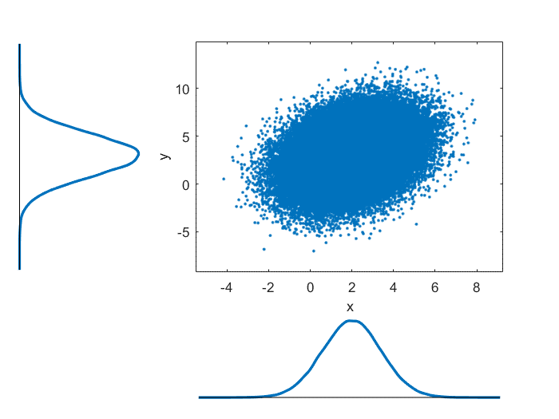
Marginal Probability Example (without the math)
All we are doing is projecting all of the data onto one of the axes (x or y in this case) and then determining the resulting one-dimensional pdf:
In practice, we will almost never have a pdf to work from, so it is not necessary for us to calculate the integral on the previous page.

Slide 28
Conditional Probability (continuous)
In practice, this can get very messy very quickly. We are dividing one function by another (as in the bivariate normal example on the next page) …

Slide 29
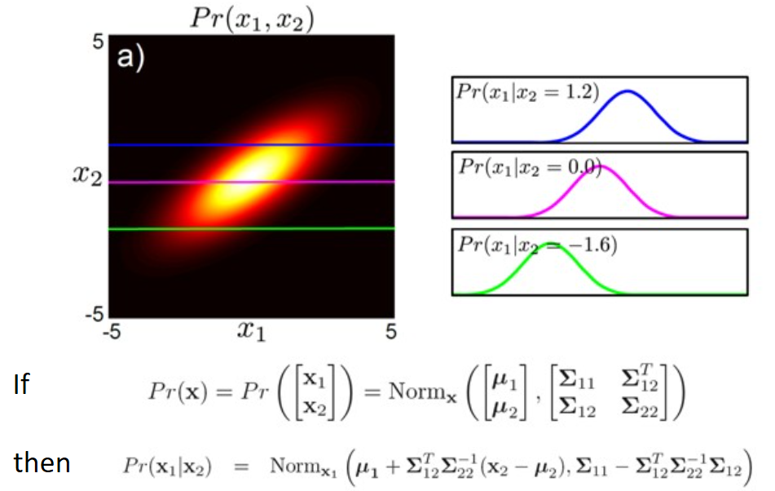
Conditional Probability Example (without the math)
Note that for a normal pdf, the conditional pdf p(x₁|x₂) has a mean that changes depending on the value of x₂, but the covariance remains the same.
new nomenclature
Norm(mean, covariance)
The idea here is to cut the joint pdf along a line in the variable being conditioned for.
The entire conditional density function over all values for that variable is the single function that describes the conditional pdf as a function of the conditioned variable.
For the example shown, picture sliding the line x₂= 1.2 or 0.0 or -1.6 over all values of x₂ and making the pdf defined by p(x₁|x₂) depend on the value of x according to how the pdf changes as that line is moved.

